Slide 1


Day 20
Math24 (Differential Equations)
Ch 3.5 Nonhomogeneous Equations; Method of Undetermined Coefficients (Page 175-186)
Elementary Differential Equations and Boundary Value Problems, 10th edition, by William E. Boyce and Richard C. DiPrima, ©2013 by John Wiley & Sons, Inc.

Slide 2


Recall the nonhomogeneous equation
where p, q, g are continuous functions on an open interval I.
The associated homogeneous equation is
In this section we will learn the method of undetermined coefficients to solve the nonhomogeneous equation, which relies on knowing solutions to the homogeneous equation.

Slide 3



Theorem 3.5.1
If Y₁ and Y₂ are solutions of the nonhomogeneous equation
then Y₁ - Y₂ is a solution of the homogeneous equation
If, in addition, {y₁, y₂} forms a fundamental solution set of the homogeneous equation, then there exist constants c₁ and c₂ such that

Slide 4

Theorem 3.5.2 (General Solution)
The general solution of the nonhomogeneous equation
can be written in the form
where y₁ and y₂ form a fundamental solution set for the homogeneous equation, c₁ and c₂ are arbitrary constants, and Y(t) is a specific solution to the nonhomogeneous equation.

Slide 5

Method of Undetermined Coefficients
Recall the nonhomogeneous equation
with general solution
In this section we use the method of undetermined coefficients to find a particular solution Y to the nonhomogeneous equation, assuming we can find solutions y₁, y₂ for the homogeneous case.
The method of undetermined coefficients is usually limited to when p and q are constant, and g(t) is a polynomial, exponential, sine or cosine function.

Slide 6



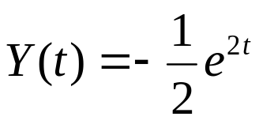
Example 1: Exponential g(t)
Consider the nonhomogeneous equation
We seek Y satisfying this equation. Since exponentials replicate through differentiation, a good start for Y is:
Substituting these derivatives into the differential equation,
Thus a particular solution to the nonhomogeneous ODE is

Slide 7



Example 2: Sine g(t), First Attempt (1 of 2)
Consider the nonhomogeneous equation
We seek Y satisfying this equation. Since sines replicate through differentiation, a good start for Y is:
Substituting these derivatives into the differential equation,
Since sin(x) and cos(x) are not multiples of each other, we must have c₁= c₂ = 0, and hence 2 + 5A = 3A = 0, which is impossible.

Slide 8


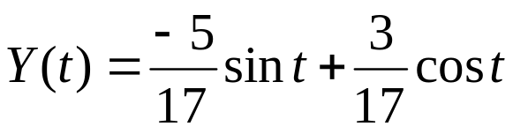
Example 2: Sine g(t), Particular Solution (2 of 2)
Our next attempt at finding a Y is
Substituting these derivatives into ODE, we obtain
Thus a particular solution to the nonhomogeneous ODE is

Slide 9



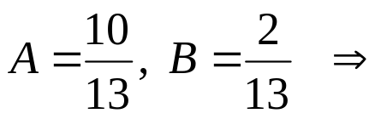
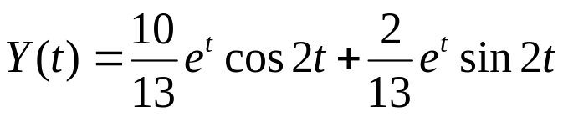
Example 3: Product g(t)
Consider the nonhomogeneous equation
We seek Y satisfying this equation, as follows:
Substituting these into the ODE and solving for A and B:

Slide 10




Discussion: Sum g(t)
Consider again our general nonhomogeneous equation
Suppose that g(t) is sum of functions:
If Y₁, Y₂ are solutions of
respectively, then Y₁ + Y₂ is a solution of the nonhomogeneous equation above.

Slide 11

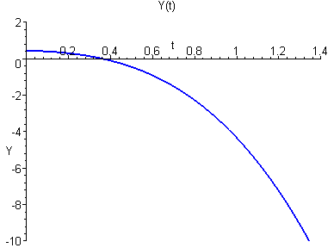


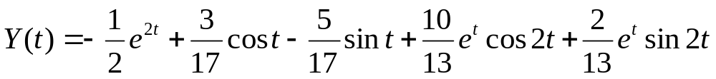
Example 4: Sum g(t)
Consider the equation
Our equations to solve individually are
Our particular solution is then

Slide 12



Example 5: First Attempt (1 of 3)
Consider the nonhomogeneous equation
We seek Y satisfying this equation. We begin with
Substituting these derivatives into differential equation,
Since the left side of the above equation is always 0, no value of A can be found to make a solution to the nonhomogeneous equation.
To understand why this happens, we will look at the solution of the corresponding homogeneous differential equation

Slide 13



Example 5: Homogeneous Solution (2 of 3)
To solve the corresponding homogeneous equation:
We use the techniques from Section 3.1 and get
Thus our assumed particular solution solves the homogeneous equation instead of the nonhomogeneous equation.
So we need another form for Y(t) to arrive at the general solution of the form:

Slide 14

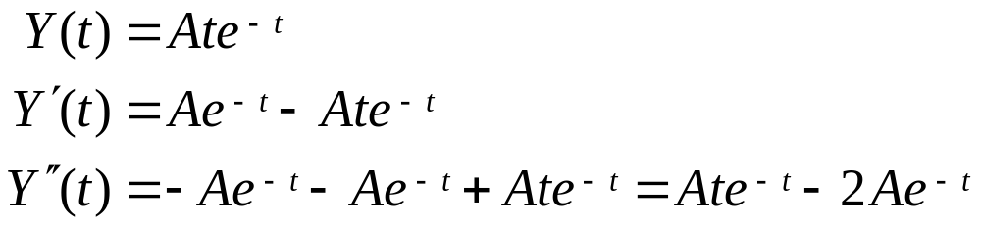
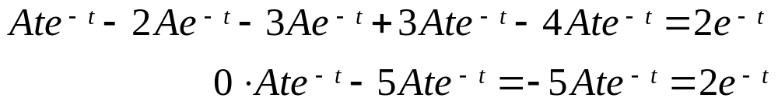
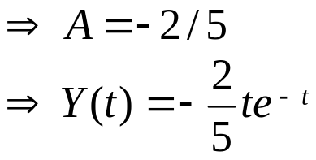
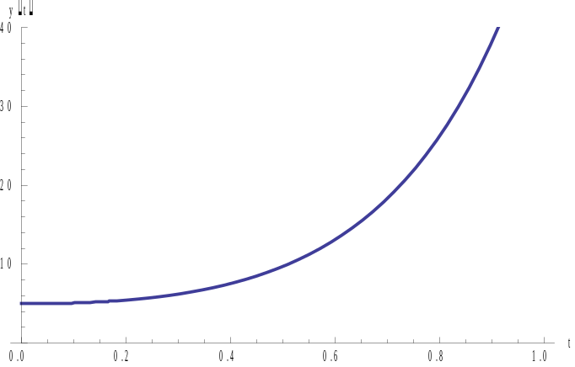


Example 5: Particular Solution (3 of 3)
Our next attempt at finding a Y(t) is:
Substituting these into the ODE,
So the general solution to the IVP is

Slide 15


Summary – Undetermined Coefficients (1 of 2)
For the differential equation
where a, b, and c are constants, if g(t) belongs to the class of functions discussed in this section (involves nothing more than exponential functions, sines, cosines, polynomials, or sums or products of these), the method of undetermined coefficients may be used to find a particular solution to the nonhomogeneous equation.
The first step is to find the general solution for the corresponding homogeneous equation with g(t) = 0.

Slide 16
Summary – Undetermined Coefficients (2 of 2)
The second step is to select an appropriate form for the particular solution, Y(t), to the nonhomogeneous equation and determine the derivatives of that function.
After substituting Y(t), Y’(t), and Y”(t) into the nonhomo-geneous differential equation, if the form for Y(t) is correct, all the coefficients in Y(t) can be determined.
Finally, the general solution to the nonhomogeneous differential equation can be written as

